Slide 1
Front-End Project Summary
Submitted By : Submitted To :
Amisha Sharma Mr. Lavish Arora
2110990160
3rd Year (Semester 5)
G5

Slide 2
Introduction
Ministore is a go-big or go-home online shop with (more than 20 pages) everything electronic you can dream of. Whether you're a tech guru, a pro, or just someone who loves cool gadgets, we've got your back.
Our aim? To make shopping as easy and exciting as your favorite online stores.
So, if you're on the hunt for anything tech-related, you'll find it all right here in one awesome place!
We wanted a name that's easy to remember. Ministore rolls off the tongue and sticks in the mind, making it simpler for our customers to return whenever they need tech products.

Slide 3
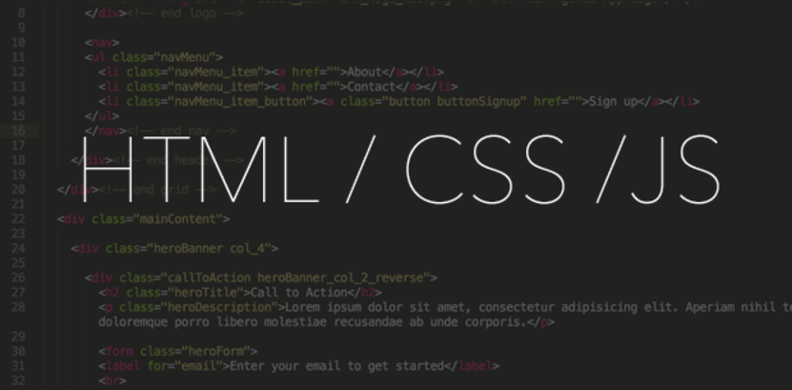
Technologies Used
The Ministore project is built using the following technologies :
HTML, CSS, and JavaScript
These three technologies are the building blocks of Ministore's front-end magic. They team up to make our website user-friendly and easy on the eyes. With this trio, users can easily explore and shop for all things electronic without a hitch.

Slide 4
Why a dark theme
We went with a dark theme for Ministore while most other online shops are rocking the white look.
It's not just about looks; it's our way of being different.
We want Ministore to be a place where you can shop comfortably and stylishly, no blending in with the crowd for us!

Slide 5
Notable Characteristics
Animated Navbar: - The website got animated icons that come to life when you hover over them. It's like a little surprise as you explore – just hover, and the icon magically reveals its name below.
Responsive Design: - The website is fully responsive, ensuring an optimal user experience across various devices and screen sizes.
Wishlists: - Users can create wish lists to save products for future reference or purchase.
Product Listings: - Users can browse, search, and filter products based on various attributes, such as brand, price range, and specifications.
Checkout and Payment: - Users can provide shipping information and review their orders before confirming payment.

Slide 6
Challenges Faced
Creating Ministore was an exciting journey, but it didn't come without its fair share of challenges.
One of the trickiest parts was conjuring up that cool "Buy Now" popup, making sure it looked just right and was user-friendly. It was a puzzle, but the satisfaction of finally nailing it made it all worthwhile.
Responsive Design: Ensuring the website is responsive across various devices and screen sizes demanded extra effort to maintain a consistent and enjoyable user experience.
Designing a Dark Theme: Choosing a dark theme, while visually appealing, required careful consideration to ensure readability and user comfort, especially in low-light conditions.

Slide 7
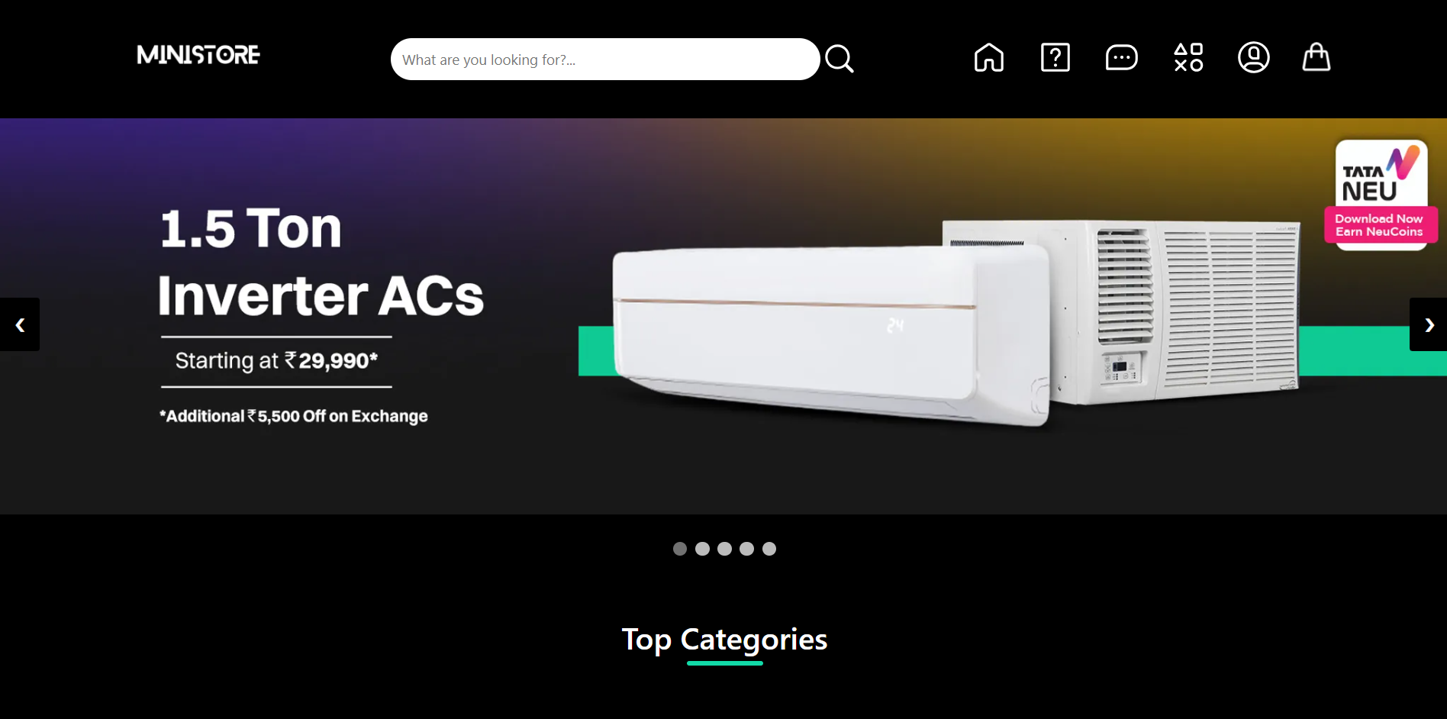
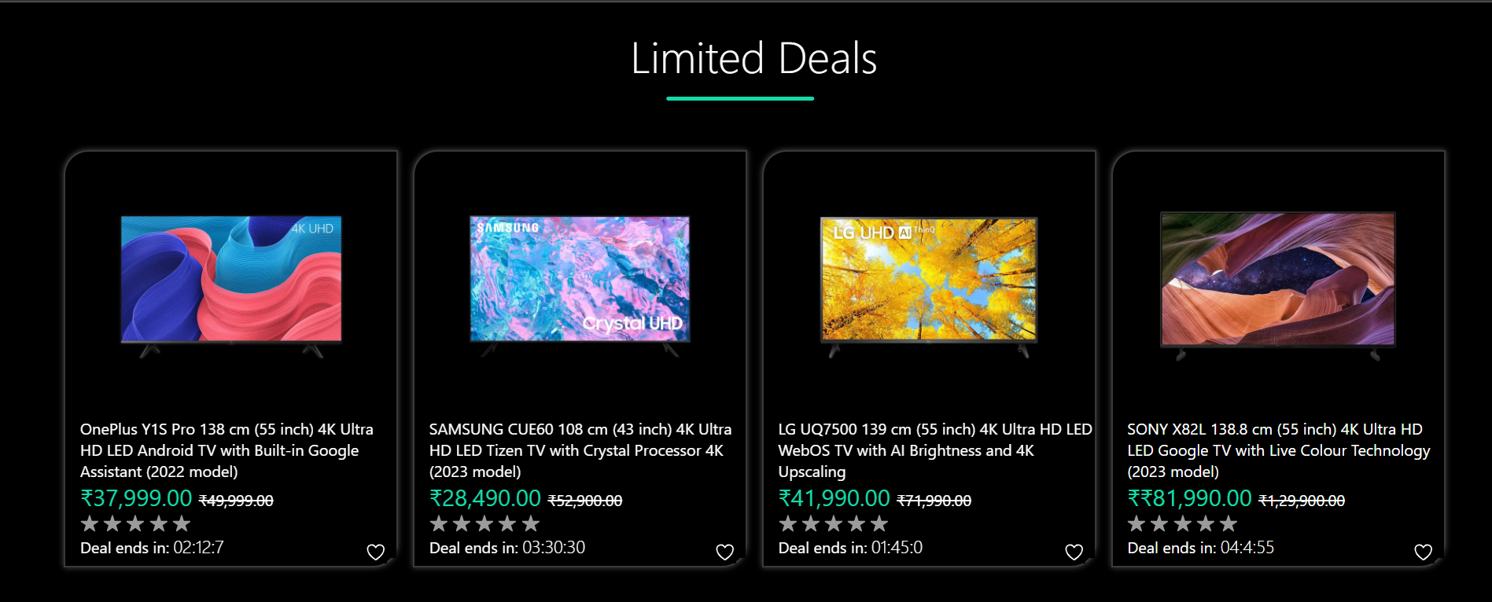
Screenshots
Landing Page
Animated navabr icons
Image caraousel using js
Different categories to choose from
Limited Deals
Option to save item for later
Ratings can be given by user
Different brands scroll bar using css

Slide 8
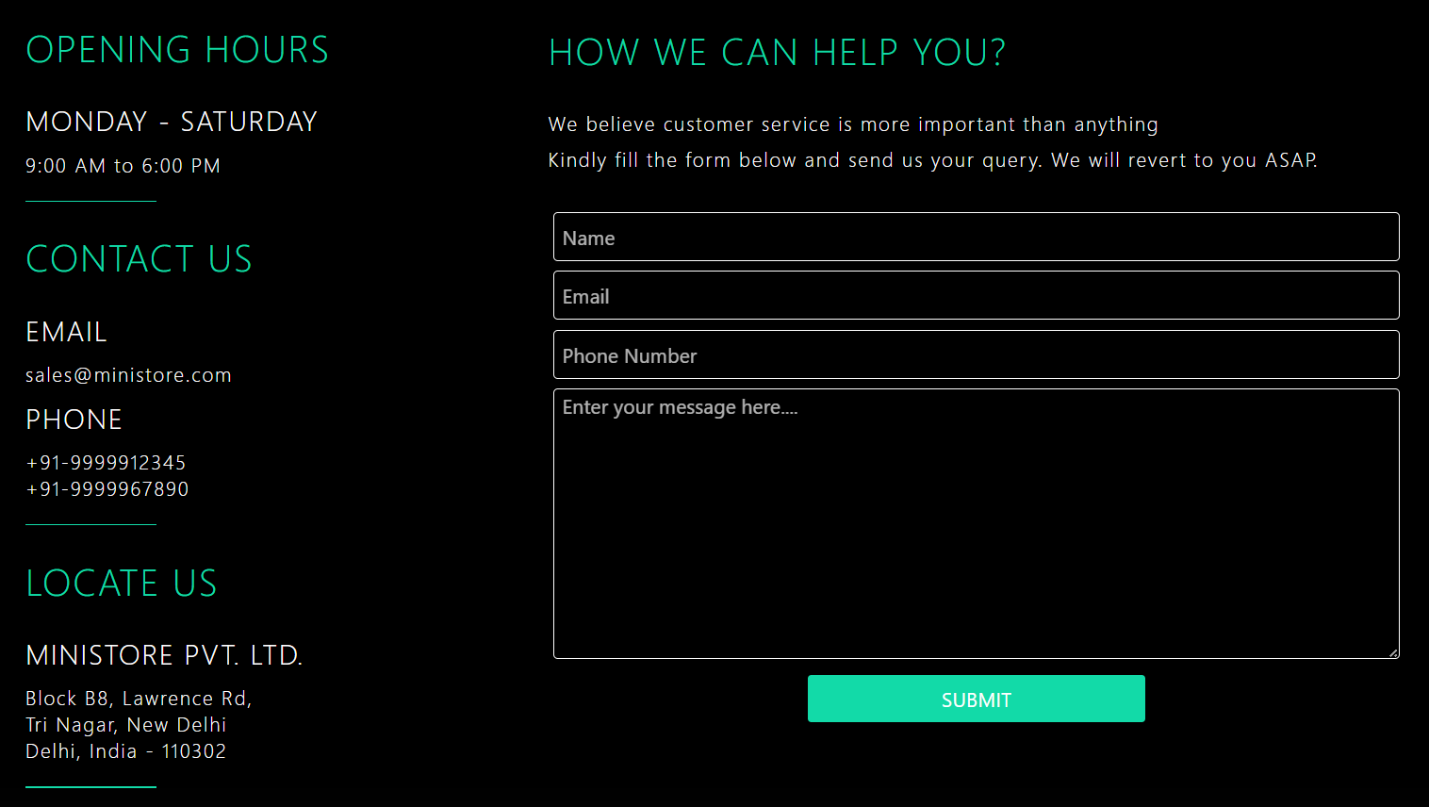
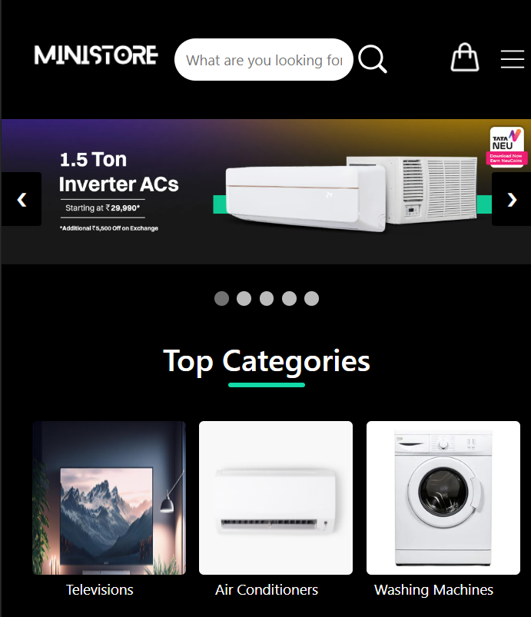
Screenshots
Contact Us Page
Information about store
Message for any help
Responsive Landing Page
On decreasing screen size, navbar collapses to a menu icon
Top Categories section fits to the width of the screen

Slide 9
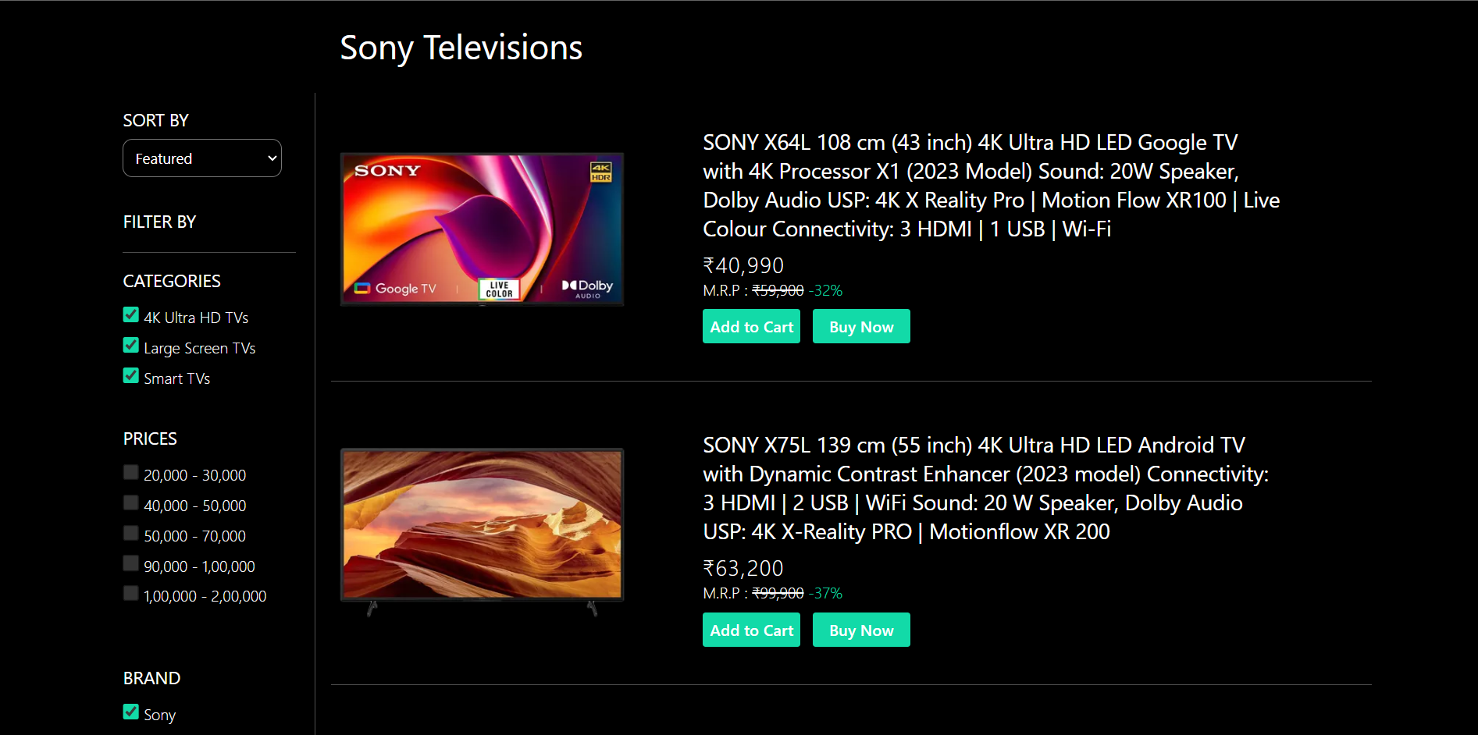
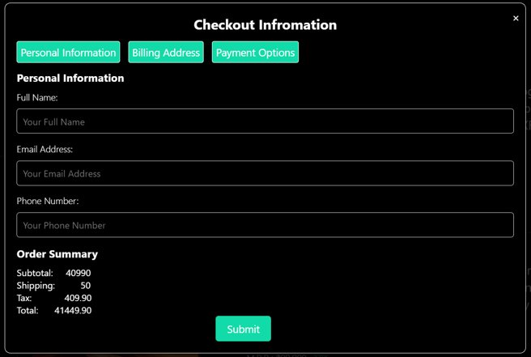
Screenshots
Sub - category page
Side bar with sorting and filtering options
Main section displays product information in a visually appealing format
"Add to Cart" and "Buy Now" buttons for user interaction.
On clicking Buy Now
A popup appears, with different sections
Order summary at the end
Submit Button to confirm purchase

Slide 10
Conclusion
Ministore isn't your average online store; it's all about diving headfirst into a world of electronics and tech. We're here to make sure your shopping journey is super smooth and fun. We've got all the cool gadgets and gizmos you need, and we're making it easy for you to find your favorites. Ministrore is your new go-to place for exploring and snagging the latest electronic goodies!

